Slide 1
linear
forest
LECTURE 4
Model Improvement,
Validation, and Interpretation
boosting
validation
Practical Machine Learning for Transcriptomics in Cancer Research
A better algorithm is the easy part. A trustworthy estimate is the hard part.
Yinxiu Zhan · IEO/UNIMI · 2026
Notes:
We keep features and improve models, how to check model performance and different interpretation levels for different models

Slide 2
RECAP
Recap, and the temptation we face today
Lectures 1-3: trustworthy problem, trustworthy model, trustworthy features.
Today: more powerful model families, proper tuning, and the validation that keeps them honest.
The temptation to resist: assuming a more complex model is automatically better.
Biological question → ML problem
✓
Building the first model
✓
Feature engineering & representation
✓
Model improvement & validation
4
Research-grade ML
5
Practical ML for Transcriptomics · Lecture 4
2
Notes:
To recap: 1 -> 2 -> 3

Slide 3
ROADMAP
Learning objectives
Compare model families; when do trees help?
Interpret outputs; prediction ≠ causation
□
□
Explain hyperparameters and tuning
Understand reproducibility principles
□
□
Understand nested cross-validation
Select a model on evidence, not complexity
□
□
Understand batch effects & correction
Avoid the field's common mistakes
□
□
Practical ML for Transcriptomics · Lecture 4
3
Notes:
Describe all of them. Common mistakes: wrong cross validation; wrong batch correction; data leakage and overfitting in hyper params tuning

Slide 4
PART 1 · WHEN IS A BASELINE NOT ENOUGH?
The burden of proof is on complexity
You already have: Logistic Regression + biological features + honest cross-validation.
The real question is not “can I build something fancier?” but “can I show it’s actually better?”
A more complex model must earn its complexity with a validated gain.
complexity
added
validated
gain
complexity must outweigh its cost
Practical ML for Transcriptomics · Lecture 4
4
Notes:
1 Logistic regression with regularization with biologically meaningful features, our prior knowledge and eval on cross validation -> 2 (you can always build fancier model) -> 3

Slide 5
PART 1 · WHEN IS A BASELINE NOT ENOUGH?
How do we know a model is “better”?
Compare on the same split, the same metrics, the same validation. Change only the model.
A difference within cross-validation noise is not an improvement.
Prefer the simpler model unless the gain is real, validated, and meaningful.
mean B > mean A — but the spreads overlap. Is it real?
CV AUC
model A
model B
Practical ML for Transcriptomics · Lecture 4
5
Notes:
Title -> 1 (this is the rule actually in every field) -> 2 -> comment figure (average is higher in B, but cross val CV overlap) -> 3

Slide 6
PART 2 · TREE-BASED MODELS
Decision trees
A decision tree is a cascade of yes/no rules (“is proliferation score > x?”).
Reads like clinical decision-making: highly interpretable for a single tree.
But single trees are unstable: small data changes → a very different tree.
And they overfit easily without constraints (depth, leaf size (min patients in a node))
proliferation > x?
yes ↙ ↘ no
ER signalling < y?
lower risk
higher risk
lower risk
Practical ML for Transcriptomics · Lecture 4
6
Notes:
The class of model we wanna describe, Tree based. First and simplest is decision tree. 1 -> figure -> 2 -> 3 (data split change, order of questions (features)) -> 3

Slide 7
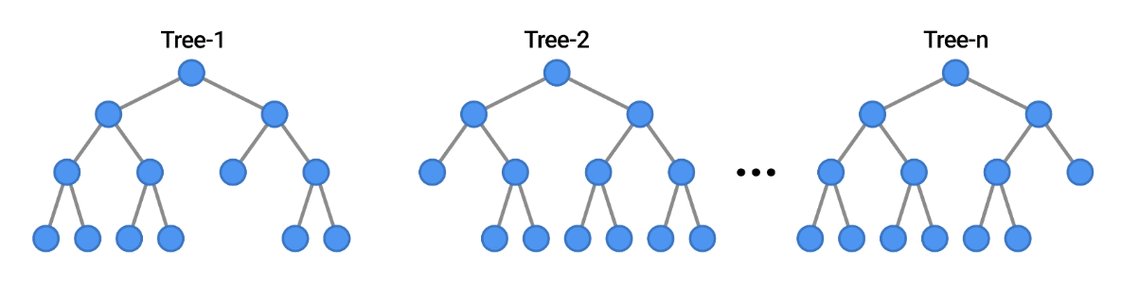
PART 2 · TREE-BASED MODELS
Random Forests
Concept: grow many trees on resampled data and varied features; let them vote.
Averaging many unstable trees → a robust, lower-variance predictor. WHY is this?
Gives a feature-importance ranking “for free” (with caveats, see later).
Limitations: less interpretable than one tree; importances biased; not magic on small n.
vote /
average
many unstable trees → one robust predictor
Practical ML for Transcriptomics · Lecture 4
7
Notes:
The instability and overfitting motivates random forests. If single overfit, what about many different trees? It works
1 -> 2 (answer to the question: errors are independent and when averaging, they cancel out, while signal stays) -> 3 (importance is the sum of all decrease in impurity across trees) -> 4

Slide 8
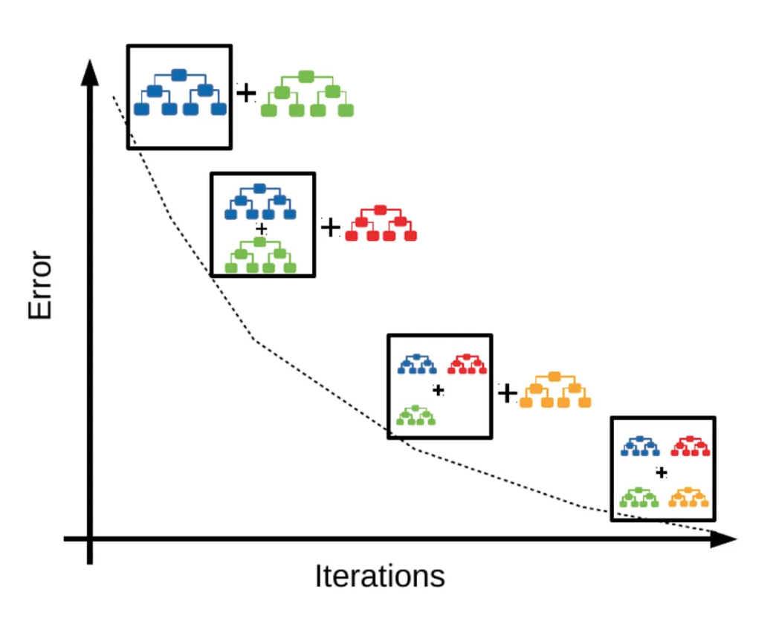
PART 2 · TREE-BASED MODELS
Gradient Boosting
Concept: build trees sequentially, each correcting the previous ones’ mistakes.
Often the strongest tabular predictor: frequently wins benchmarks over the other two.
But it is the easiest to overfit, and the most sensitive to tuning. Especially in p>>n regime
Practical ML for Transcriptomics · Lecture 4
8
Notes:
Contrast between RF and GB: 1 -> 2 -> 3 (wins but not generalizable because we overfit the tuning)

Slide 9
PART 2 · TREE-BASED MODELS
Which model family, when?
Interpretability
Stability
Tuning burden
Typical improvement (p ≫ n)
Regularised LR
High
High
Low
(the baseline)
Random Forest
Medium
High
Low-Med
Small
Gradient Boosting
Low
Med
High
ok (high risk)
Practical ML for Transcriptomics · Lecture 4
9
Notes:
R LR ok -> RF (interpretability less than LR, but it is interpretable. One often takes RF across CV and do GO) ->

Slide 10
PART 3 · HYPERPARAMETER OPTIMISATION
Parameters vs hyperparameters
Parameters are learned from the data during fitting (e.g. gene coefficients).
Hyperparameters are set before fitting and control the model (tree depth, number of trees, penalty lambda).
You don’t learn hyperparameters by fitting: you search for good ones and must validate it.
Which data splits to use for hyper params tuning?
learned FROM data
chosen BEFORE fitting
(parameters)
(hyperparameters)
• gene coefficients
• tree split thresholds
• tree depth
• number of trees
• penalty strength C
Practical ML for Transcriptomics · Lecture 4
10
Notes:
Now the fitting vs tuning part. ML is a function with parameters you find the values of parameters to get a function such that given the input, the output of the function fits well the labels in the train data. 1 -> 2 -> 3 -> 4. The way you can do it: train, val, test -> train and val used for hyper params tuning -> test as ext validation -> overfit tuning as we will see

Slide 11
PART 3 · HYPERPARAMETER OPTIMISATION
Grid and random search
Grid search: try every combination on a predefined grid, thorough but expensive.
Random search: sample combinations at random, often finds good values far cheaper. WHY?
Each candidate is scored by cross-validation, never on the final test set.
Computational cost explodes with the number of hyperparameters. e.g. 5 hyper parameters, 10 values each, 5 CV: 500k trials!
grid search
random search
same budget, better coverage of what matters
Practical ML for Transcriptomics · Lecture 4
11
Notes:
How to tune: different strategy_
1 -> 2 (because very often model perform depends on few hyperparams -> you waste a lot of resources on the ones that do not change with grid search) ->3 cross val (with caution) -> 4

Slide 12
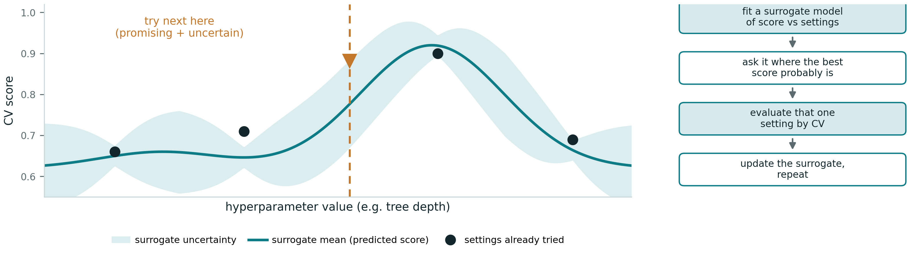
PART 3 · HYPERPARAMETER OPTIMISATION
Bayesian search
Grid and random ignore what they’ve learned. Bayesian search uses past results to decide where to look next.
Fit a cheap surrogate model of CV score as a function of the hyperparameters.
Use it to pick the next setting that balances promising vs unexplored, evaluate it, update, repeat.
Reaches good settings in far fewer evaluations: useful when each CV fit is slow.
Still scored by cross-validation, never the test set: the leakage rules are unchanged.
Practical ML for Transcriptomics · Lecture 4
12
Notes:
Follow the slide

Slide 13
PART 3 · HYPERPARAMETER OPTIMISATION
The danger hiding in tuning
Every time you tune to the validation score, you “use up” a little of its honesty.
Tune hard enough and your validation score becomes optimistic → you’ve overfit the tuning!
The fix is structural, not trying harder — enter nested cross-validation.
reported validation score
gap = optimism
true performance
→ tuning effort
Practical ML for Transcriptomics · Lecture 4
12
Notes:
The danger in tuning,

Slide 14
PART 4 · VALIDATION BEYOND SIMPLE CV
Cross-validation review
k-fold CV: rotate the held-out fold, average: a more stable estimate than one split.
Everything data-dependent (scaling, selection) refits inside each fold
This estimates performance for a fixed modelling choice.
But what if the modelling choice itself (the hyperparameters) was selected using the data?
each row: 4 training folds + 1 held-out (amber)
Practical ML for Transcriptomics · Lecture 4
13
Notes:
Cross validation review: 1 -> 2 -> 3 ->4 ( this uses up the cross val) -> optimistic estimates!

Slide 15
PART 4 · VALIDATION BEYOND SIMPLE CV
Nested cross-validation (the concept)
Two loops: an inner loop selects hyperparameters; an outer loop estimates performance.
The outer fold is never used to choose anything: it only judges the finished, tuned model.
Result: an honest performance estimate that includes the cost of tuning.
Expensive, but the correct way to report tuned-model performance.
It does not choose parameters, it evaluates the model!
OUTER: estimate performance
held-out outer fold → judges only
INNER: select hyperparameters (on outer-training folds)
inner CV chooses the best configuration; outer fold never sees it
Practical ML for Transcriptomics · Lecture 4
14
Notes:
Solution is nested cross validation. 1 -> 2 -> example on the right -> 3 -> 4 -> 5

Slide 16
PART 4 · VALIDATION BEYOND SIMPLE CV
Why nested CV matters in practice
Without it, tuned models report optimistic scores that don’t replicate.
The main cause: small n, many hyperparameters, flexible models.
Rule: if you tuned on it, you cannot also report performance on it.
gap = tuning optimism
Practical ML for Transcriptomics · Lecture 4
15
Notes:
Read slide

Slide 17
PART 5 · BATCH EFFECTS AND CORRECTION
Why models fail on new cohorts
A model can look great in-cohort and collapse on an independent dataset.
Model is good. Input is different (different normalization, batch effect, etc..).
Our setting: METABRIC (Illumina) vs GSE6532 (Affymetrix): different platforms, real batch.
Cross-cohort validation is the closest thing to truth before a clinical trial.
in-cohort CV does not predict cross-platform transfer
Practical ML for Transcriptomics · Lecture 4
16
Notes:
Now let’s move to the reason why models fail on new cohorts. This will happen -> 1 -> 2 it’s possible that the model is good but data different (different scale, different norm) -> figure -> 3 out setting -> we expect different scales -> 4

Slide 18
PART 5 · BATCH EFFECTS AND CORRECTION
Batch correction: ComBat and friends
ComBat or quantile normalization methods estimate and subtract batch effects.
Benefit: cohorts become comparable; cross-platform models can work.
Risk: aggressive correction can remove real biology (how?) or leak the outcome (next slide).
Pathway features are a gentler, more platform-robust alternative.
before: batch-separated
after: intermixed (biology kept)
over-correction can erase real biology — handle with care
Practical ML for Transcriptomics · Lecture 4
18
Notes:
How to correct for batch? Title -> 1 -> 2 -> 3 (answer: some information just align with batch and these might be important) -> 4

Slide 19
PART 5 · BATCH EFFECTS AND CORRECTION
Where batch correction belongs in the pipeline
Correction must not use the outcome label, and must respect the split.
Estimate correction on training data; apply the same transform to validation/test.
Correcting train + test together, using all data, is a leakage.
RULE: start always with raw counts! Not normalized or batch corrected!
If batch is perfectly confounded with outcome, no method can rescue it: design matters more.
split
estimate correction
on TRAIN only
apply same transform
to held-out
model → evaluate
✗ correct train + test together (leakage)
…and if batch is perfectly confounded with outcome, only better design — not any method — can help.
Practical ML for Transcriptomics · Lecture 4
19
Notes:
READ the slide

Slide 20
PART 6 · MODEL INTERPRETATION
Feature importance and coefficients (and their traps)
Three interpretation tools: linear coefficients, tree-based importance, SHAP values (next slide).
Linear coefficients: direction + magnitude, but unstable/split with correlated partners (use pathways)
Random-forest importance: ranks usefulness for splitting, but is biased and unstable.
Correlated genes share/split importance: a top gene can be an artefact of correlation.
Always check stability across folds/resamples before believing a ranking.
All answer “what is the model using?” None answer “what causes recurrence?”
proliferation
ER signalling
gene A
immune
gene B
believe the stable features (small error bars), not the lucky ones
Practical ML for Transcriptomics · Lecture 4
21
Notes:
Interpreatation is important. 1-> 2 -> 3 -> 4→ 5 ->6

Slide 21
PART 6 · MODEL INTERPRETATION
SHAP values
SHAP attributes each prediction to its features: a consistent, per-patient explanation.
Useful: shows how the model reached a decision for an individual tumour.
Limit: it explains the model, not the biology: a faithful explanation of a flawed model is still flawed.
Limit: correlated features get split contribution
Never present SHAP as evidence of mechanism or causation.
proliferation
tumour size
immune
ER signalling
← lowers risk raises risk →
Practical ML for Transcriptomics · Lecture 4
22
Notes:
When a model does not give you the importance score -> use shap -> 1 -> 2 -> 3 -> 4 -> 5

Slide 22
PART 7 · REPRODUCIBILITY
Reproducibility
Random seeds: fix them, report them: results that change run-to-run aren’t results.
Pipelines: encapsulate preprocessing + model so the whole thing refits inside CV (no leakage).
Version control + environment capture: same code + data + versions = same result.
Notebook organisation and experiment tracking: every reported number is regenerable.
fixed random seed
encapsulated pipeline
version control + env
tracked experiment
regenerable result
Practical ML for Transcriptomics · Lecture 4
24

Slide 23
PART 8 · CHOOSING THE BEST MODEL
Choosing the best model
The best model is not the most complex, nor the one with the highest training score.
The best model is robust, interpretable, reproducible, and well-validated.
Decision rule: prefer the simplest model whose advantage survives honest validation.
For a clinic-bound biomarker, trust and transferability beat a fractional AUC gain.
robustness
reproducibility
not just AUC
interpretability
validation
Practical ML for Transcriptomics · Lecture 4
26
Notes:
1 -> 2 -> 3 -> 4

Slide 24
THE MAIN MESSAGE
“Better validation is usually more important than a better algorithm.”
Most performance gains are smaller than expected; validation errors do more damage than model choice.
Interpretation requires caution; biological plausibility does not prove causality.

Slide 25
RECAP
Recap & bridge to the practical
Objectives — ticked
In the practical
✓ Compare model families; when trees help
✓ Hyperparameters & tuning (grid/random)
✓ Nested cross-validation
✓ Batch effects & correction in the pipeline
✓ Interpretation; prediction ≠ causation
✓ Reproducibility; choosing on evidence
Compare LR / Random Forest / Gradient Boosting on the SAME features
Tune one model (grid / random search)
Estimate honestly with nested CV — measure the optimism gap
Batch-correction experiment: METABRIC → GSE6532, with vs without
Interpret importances responsibly; choose a model for publication
Next: research-grade ML — survival models, external validation at scale.
Practical ML for Transcriptomics · Lecture 4
28
Notes:
2 min. Tick objectives. Practical: compare LR/RF/GBM on the same features; tune one with grid/random search; estimate honestly with nested CV; batch-correction experiment (METABRIC->GSE6532, with/without); interpret importances responsibly; choose a model for publication. Next: research-grade ML -- survival models, external validation at scale.

Slide 26
Notes:
2 min. Tick objectives. Practical: compare LR/RF/GBM on the same features; tune one with grid/random search; estimate honestly with nested CV; batch-correction experiment (METABRIC->GSE6532, with/without); interpret importances responsibly; choose a model for publication. Next: research-grade ML -- survival models, external validation at scale.

Slide 27
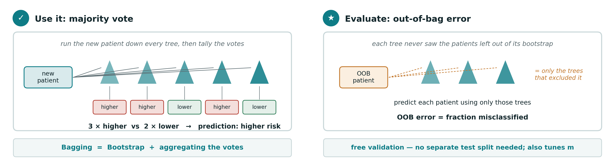
Random forests — using and evaluating
Once the forest is built, prediction and validation both fall out of the same bootstrap trick.
Tune the forest by trying different m (genes per split) and picking the value with the lowest out-of-bag error.
Practical ML for Transcriptomics · Lecture 4

Slide 28
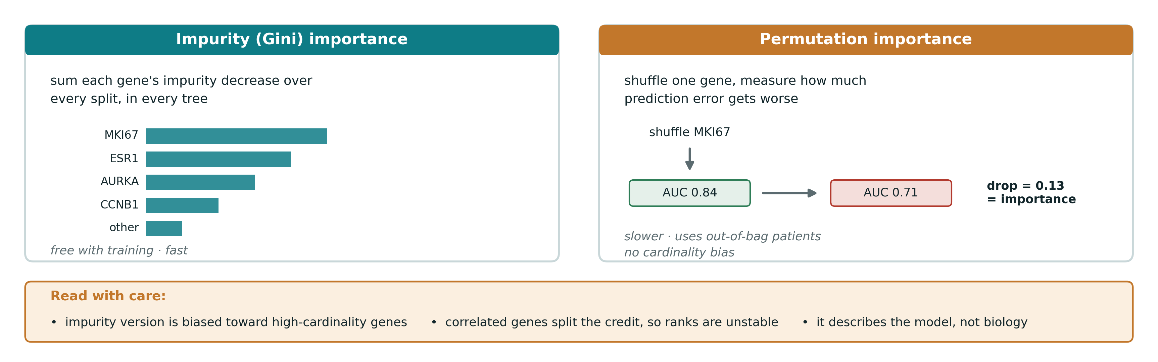
Feature importance from a random forest
One number per gene: how much it helped the forest predict, summed across all trees. Two ways to measure it.
Use it as a fast first look; reach for SHAP (Lecture 3) when the ranking actually drives a decision.
Practical ML for Transcriptomics · Lecture 4

